Slide 1
11/14/18 Meeting Update
A few more things to do, but I just want AlottaPie™

Slide 2
General
Power:
Waiting on buck boost converter, fuel gauge, ldos to arrive.
Solar tests proceeding.
Comms:
Integrated code for transmission with sensor code.
Waiting on fuel gauge to have conditional transmission.
Sensor:
Transitioned to interrupt-based data acquisition.
Working on implementing longer clock cycle (hourly schedule) and writing to FRAM.
Found a potential sensor resource- Nadya (522 TA)
System diagram for prototype #1

Slide 3
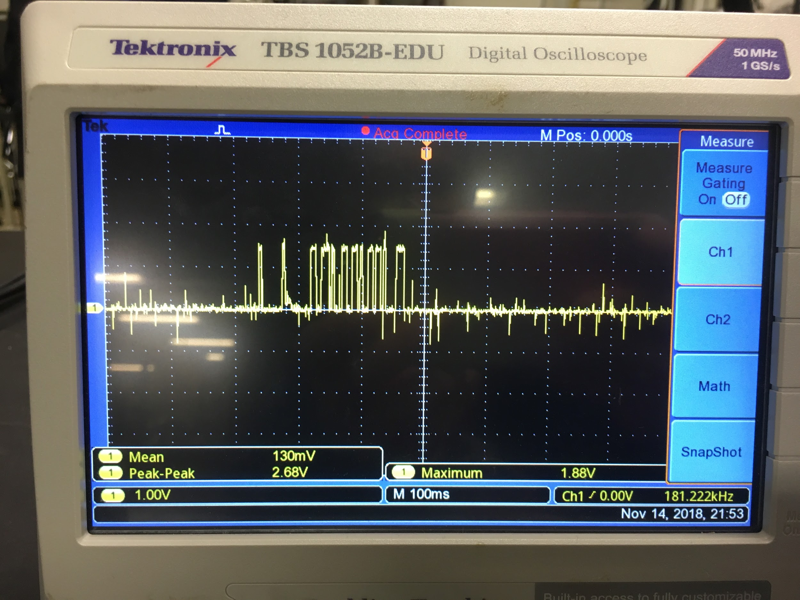
Interrupt- Based Sensing
 | Current (mA)
Avg | 0.13
Peak | 1.8
I2C Interrupt-based
Measured over 100Ω resistor
*Going to take these measurements again
10x

Slide 4
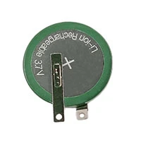
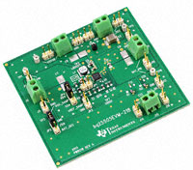
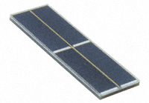
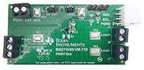
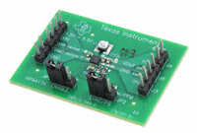
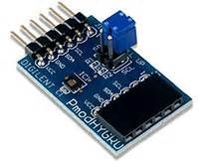
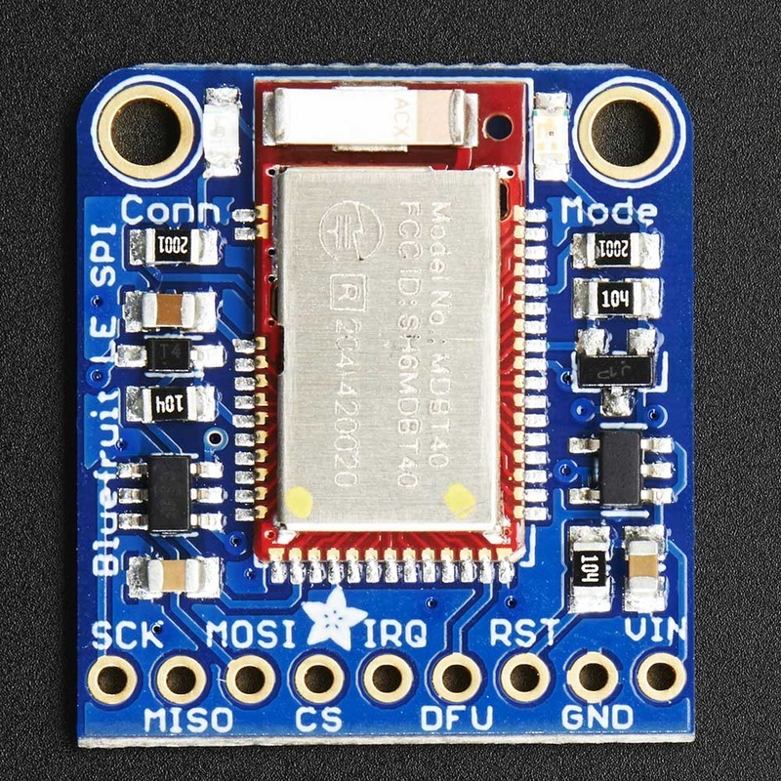
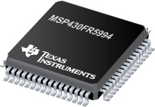
3.7V, 110 mAh Li Ion Battery
BQ25505EVM Energy Harvester
Monocrystalline Solar panel
VDD
GND
BQ27426 Fuel Gauge
TPS63030 Buck Boost Converter
I2C CLK
IRQ
I2C SDA
SPI CS
I2C CLK
SPI CLK
I2C SDA
SPI MOSI
SPI MISO
HDC1080 Temp/Hum Sensor
MSP430 Processor
RST
Bluefruit Bluetooth Module

Slide 5

Power
Waiting for parts to come in
They are in transit, hoping to incorporate them this weekend
These include the fuel gauge, and 2 buck-boost converters
Currently working on schematic + board layout while waiting
In the process of putting together PCB layout as a guideline for next prototype
Gathering some data from solar cells
Winter is coming. This has made things problematic
Will begin compiling power system characterization into some form of document over the next week or two.
“Nothing goes with turkey like energy harvesting”™

Slide 6
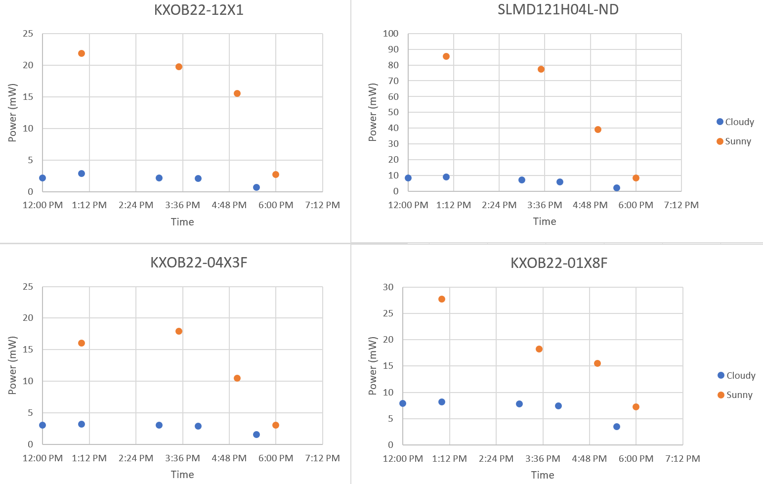
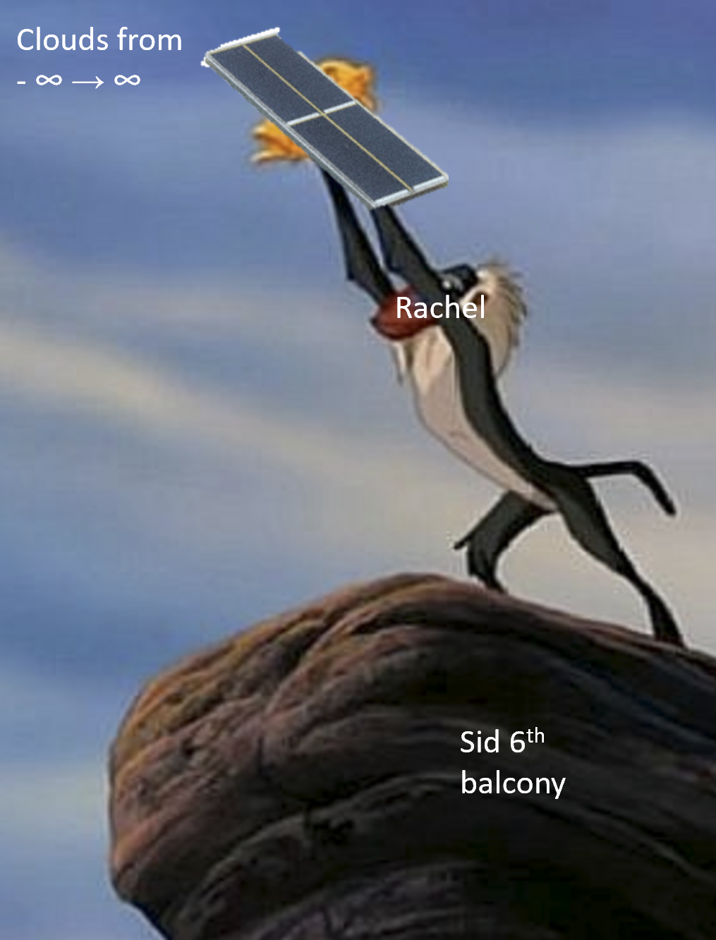
Solar Cells

